Slide 1

TRAFFIC AUTOMATION
SYSTEM

Slide 2
CONTENTS
Mentors & Team Members
Problem Statement
End Product
Basic Use Case
Who can use this system?
Future Scope
Paid Features
Demo
References

Slide 3
MENTORS
TEAM MEMBERS
APARNA GUPTA
BISWAJEET SENAPATI
DINUP PILLAI
NEHA RAJESH
NEHA SURESH
RENJU R H
SAFA N
SIVADARSHANA UNNI
THEJA ANNA MATHEW

Slide 4
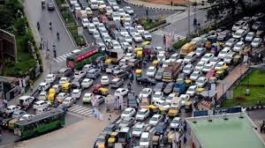
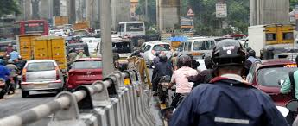
PROBLEM STATEMENT
Traffic congestion problems consist of incremental delay, vehicle operating costs such as fuel consumption, pollution emissions and stress that result from interference among vehicles in the traffic stream.
Lack of an efficient Traffic management to replace the faulty and inefficient manual system leading to congestion and for critical emergency vehicles.
The congestion of urban traffic has become one of the critical issue.

Slide 5
END PRODUCT
End Product is a traffic light controller based model on Image Processing.
Our proposed system aims to use real time images from the CCTV cameras at traffic junctions for real-time traffic density calculations.
The side with maximum number of vehicles will be allotted the green signal with a timer equivalent to count of number of vehicles detected in the traffic side.

Slide 6
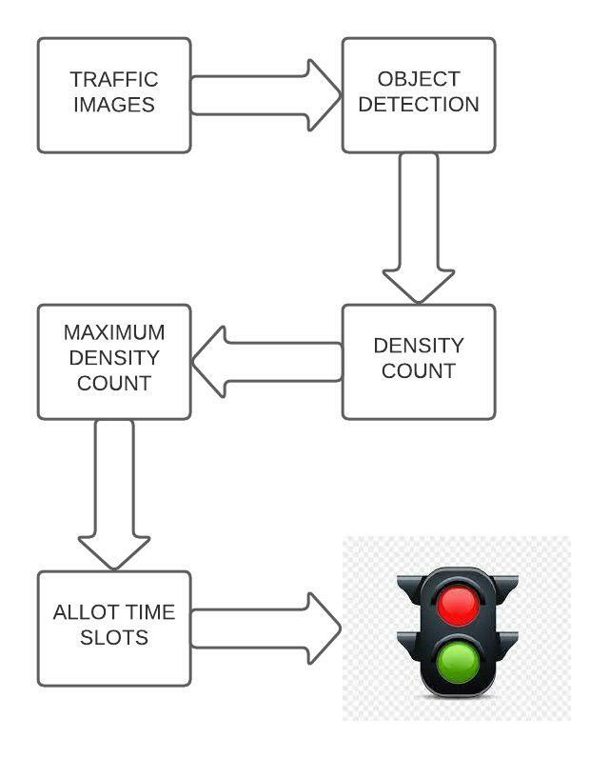
BASIC USE CASE

Slide 7
WHO CAN USE THIS SYSTEM?
This system will help us to reduce the traffic problem by setting the timer of these traffic signals according to the vehicle density in each direction.
Ministry of Road & Transport.
Can be used in any intersection points.

Slide 8


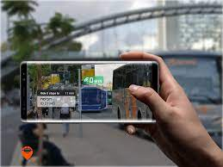
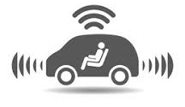
FUTURE SCOPE
CCTV Cameras are used at the traffic junction.
A real-time traffic management system (TMS) using the Internet of Things (IoT) and data analytics.
Augmented Reality applications can enhance intelligent transportation system.
Use automated and connected vehicle technology.

Slide 9
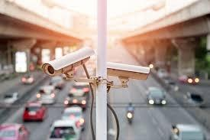
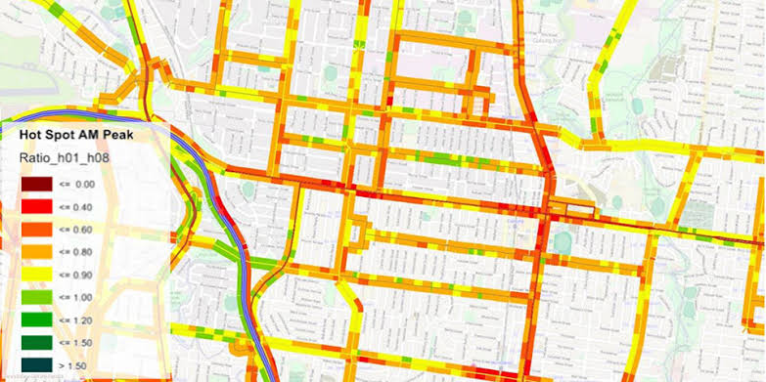
PAID FEATURES
Installation of CCTV cameras at any intersection points.
Procuring dataset for GPS Trajectories for Indian Road.

Slide 10
DEMO

Slide 11
REFERENCES
https://pysource.com/
https://medium.com/analytics-vidhya/yolov4-vs-yolov4-tiny-97932b6ec8ec
https://docs.python.org/3/library/turtle.html
https://www.google.com/amp/s/blog.roboflow.com/a-thorough-breakdown-of-yolov4/amp/
https://docs.python.org/3/library/tk.html

Slide 12
THANK YOU

